Slide 1
New Idea:
NL-Means Filter (Buades 2005)
Same goals: ‘Smooth within Similar Regions’
KEY INSIGHT: Generalize, extend ‘Similarity’
  Bilateral:
  Averages neighbors with similar intensities;
  NL-Means:
  Averages neighbors with similar neighborhoods!

Slide 2
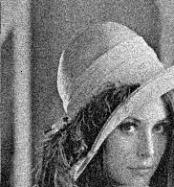
NL-Means Method:
Buades (2005)
For each and
every pixel p:

Slide 3
NL-Means Method:
Buades (2005)
For each and
every pixel p:
  Define a small, simple fixed size neighborhood;

Slide 4
NL-Means Method:
Buades (2005)
For each and
every pixel p:
  Define a small, simple fixed size neighborhood;
  Define vector V_{p}: a list of neighboring pixel values.
0.74
0.32
0.41
0.55
…
…
…
V_{p} =

Slide 5
NL-Means Method:
Buades (2005)
q
‘Similar’ pixels p, q
→ SMALL
vector distance;
p
|| V_{p} – V_{q} ||²

Slide 6
NL-Means Method:
Buades (2005)
q
‘Dissimilar’ pixels p, q
→ LARGE
vector distance;
q
p
|| V_{p} – V_{q} ||²

Slide 7
NL-Means Method:
Buades (2005)
‘Dissimilar’ pixels p, q
→ LARGE
vector distance;
Filter with this!
q
p
|| V_{p} – V_{q} ||²

Slide 8
NL-Means Method:
Buades (2005)
p, q neighbors define
a vector distance;
Filter with this:
No spatial term!
q
|| V_{p} – V_{q} ||²
p

Slide 9
NL-Means Method:
Buades (2005)
pixels p, q neighbors
Set a vector distance;
Vector Distance to p sets
weight for each pixel q
q
|| V_{p} – V_{q} ||²
p

Slide 10
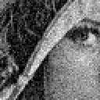
NL-Means Filter (Buades 2005)
Noisy
source
image:

Slide 11
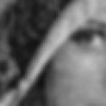
NL-Means Filter (Buades 2005)
Gaussian
Filter
Low noise,
Low detail

Slide 12

NL-Means Filter (Buades 2005)
Bilateral
Filter
(better, but
similar
‘stairsteps’:

Slide 13

NL-Means Filter (Buades 2005)
NL-Means:
Sharp,
Low noise,
Few artifacts.

